Slide 1

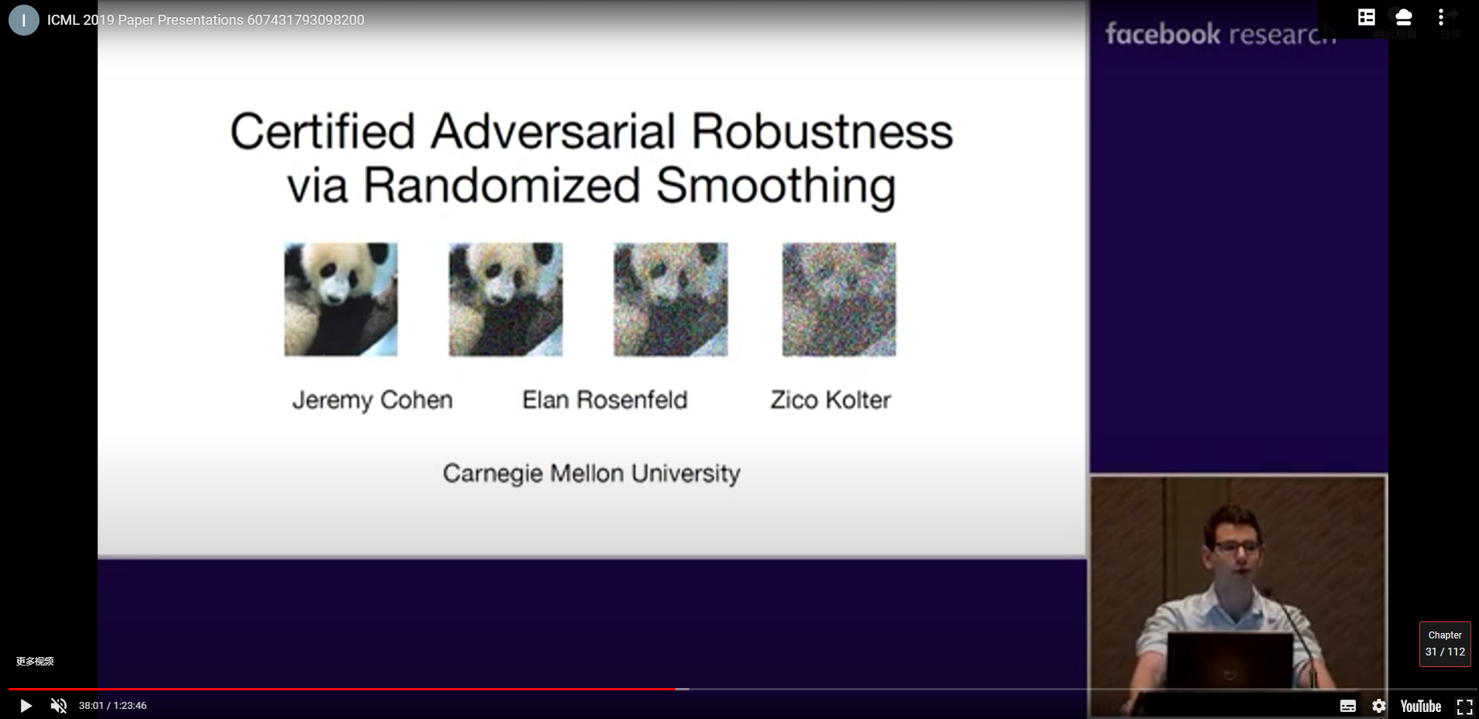
Certified Adversarial Robustness via Randomized Smoothing
Jeremy Cohen, Elan Rosenfeld, J. Zico Kolter
Carnegie Mellon University
ICML 2019

Slide 2
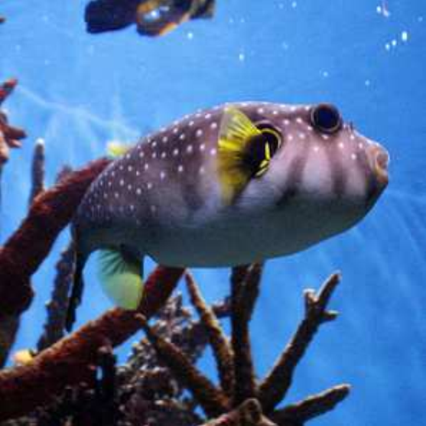
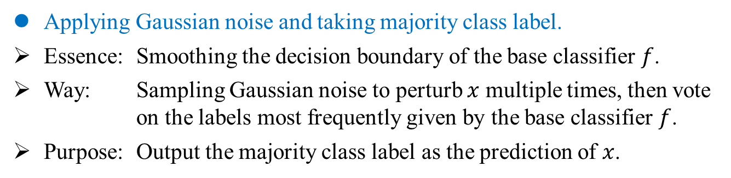
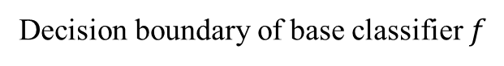
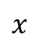
Randomized Smoothing
Overview
Applying Gaussian noise and taking majority class label.
Essence: Smoothing the decision boundary of the base classifier $f$.
Way: Sampling Gaussian noise to perturb $x$ multiple times, then vote on the labels most frequently given by the base classifier $f$.
Purpose: Output the majority class label as the prediction of $x$.
$$x$$
Decision boundary of base classifier $f$
Cohen, Jeremy, Elan Rosenfeld, and Zico Kolter. Certified adversarial robustness via randomized smoothing. ICML 2019.

Slide 3
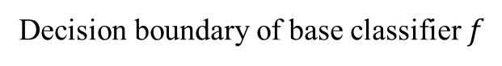
Randomized Smoothing
Overview
Applying Gaussian noise and taking majority class label.
Essence: Smoothing the decision boundary of the base classifier $f$.
Way: Sampling Gaussian noise to perturb $x$ multiple times, then vote on the labels most frequently given by the base classifier $f$.
Purpose: Output the majority class label as the prediction of $x$.
$$x$$
Decision boundary of base classifier $f$
Cohen, Jeremy, Elan Rosenfeld, and Zico Kolter. Certified adversarial robustness via randomized smoothing. ICML 2019.

Slide 4
Randomized Smoothing
Overview
Applying Gaussian noise and taking majority class label.
Essence: Smoothing the decision boundary of the base classifier $f$.
Way: Sampling Gaussian noise to perturb $x$ multiple times, then vote on the labels most frequently given by the base classifier $f$.
Purpose: Output the majority class label as the prediction of $x$.
$$x$$
Decision boundary of base classifier $f$
Cohen, Jeremy, Elan Rosenfeld, and Zico Kolter. Certified adversarial robustness via randomized smoothing. ICML 2019.

Slide 5
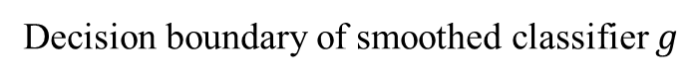
Randomized Smoothing
Overview
Applying Gaussian noise and taking majority class label.
Essence: Smoothing the decision boundary of the base classifier $f$.
Way: Sampling Gaussian noise to perturb $x$ multiple times, then vote on the labels most frequently given by the base classifier $f$.
Purpose: Output the majority class label as the prediction of $x$.
$$x$$
Decision boundary of smoothed classifier $g$
Cohen, Jeremy, Elan Rosenfeld, and Zico Kolter. Certified adversarial robustness via randomized smoothing. ICML 2019.

Slide 6
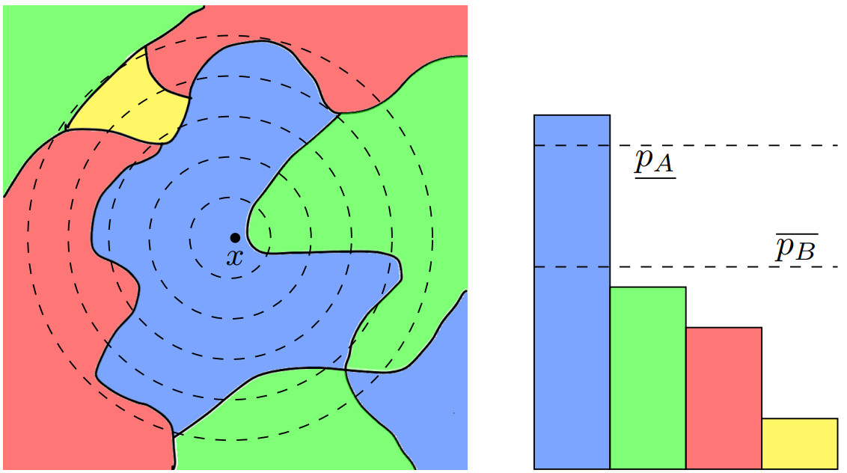
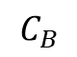
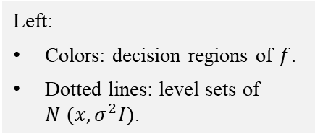
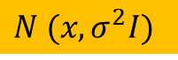
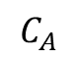
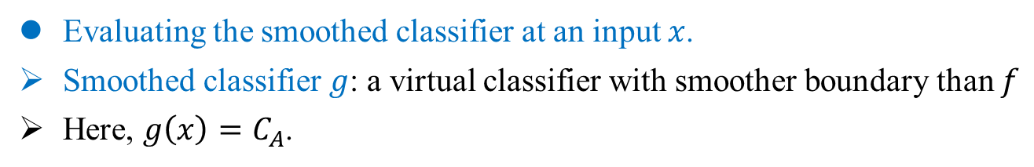
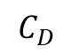
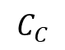
Randomized Smoothing
Overview
Evaluating the smoothed classifier at an input $x$.
Smoothed classifier $g$: a virtual classifier with smoother boundary than $f$
Here, $g\left(x\right)=C_{A}$.
$$C_{B}$$
$$C_{C}$$
$$C_{D}$$
$$C_{A}$$
Left:
Colors: decision regions of $f$.
Dotted lines: level sets of $N (x, σ^{2}I)$.
$N (x, σ^{2}I)$
Figure 1
Cohen, Jeremy, Elan Rosenfeld, and Zico Kolter. Certified adversarial robustness via randomized smoothing. ICML 2019.

Slide 7
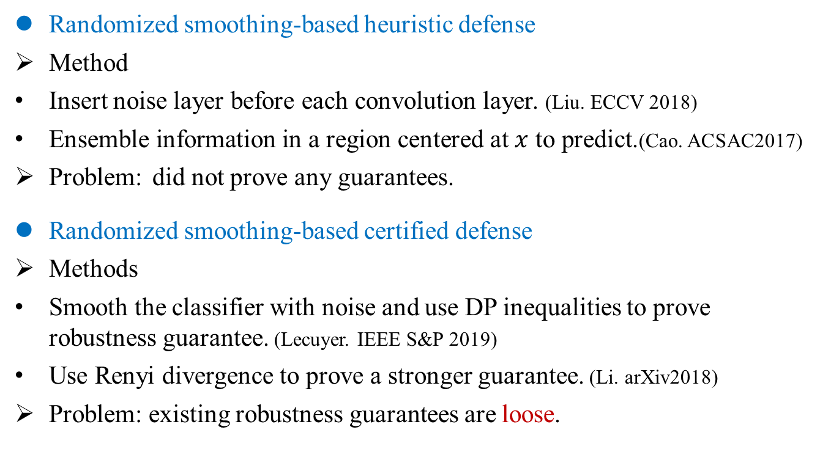
Randomized Smoothing
Problem
Randomized smoothing-based heuristic defense
Method
Insert noise layer before each convolution layer. (Liu. ECCV 2018)
Ensemble information in a region centered at $x$ to predict.(Cao. ACSAC2017)
Problem: did not prove any guarantees.
Randomized smoothing-based certified defense
Methods
Smooth the classifier with noise and use DP inequalities to prove robustness guarantee. (Lecuyer. IEEE S&P 2019)
Use Renyi divergence to prove a stronger guarantee. (Li. arXiv2018)
Problem: existing robustness guarantees are loose.
Liu, Xuanqing. Towards robust neural networks via random self-ensemble. ECCV 2018.
Cao, Xiaoyu. Mitigating evasion attacks to deep neural networks via region-based classification. ACSAC2017.
Lecuyer, Mathias. Certified robustness to adversarial examples with differential privacy. IEEE S&P 2019.
Li, Bai, et al. "Second-order adversarial attack and certifiable robustness." arXiv2018.

Slide 8
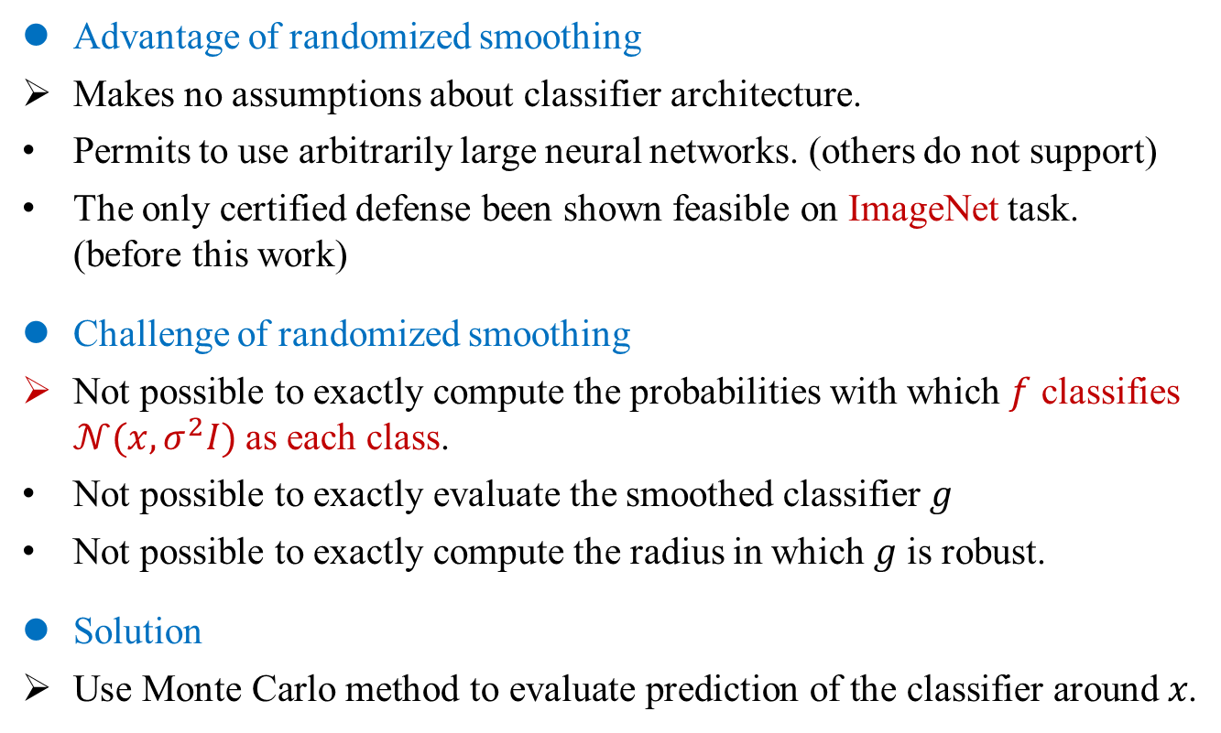
Randomized Smoothing
Problem
Advantage of randomized smoothing
Makes no assumptions about classifier architecture.
Permits to use arbitrarily large neural networks. (others do not support)
The only certified defense been shown feasible on ImageNet task. (before this work)
Challenge of randomized smoothing
Not possible to exactly compute the probabilities with which $f$ classifies $𝒩(x,σ^{2}I)$as each class.
Not possible to exactly evaluate the smoothed classifier 𝑔
Not possible to exactly compute the radius in which 𝑔 is robust.
Solution
Use Monte Carlo method to evaluate prediction of the classifier around 𝑥.
Cohen, Jeremy, Elan Rosenfeld, and Zico Kolter. Certified adversarial robustness via randomized smoothing. ICML 2019.

Slide 9
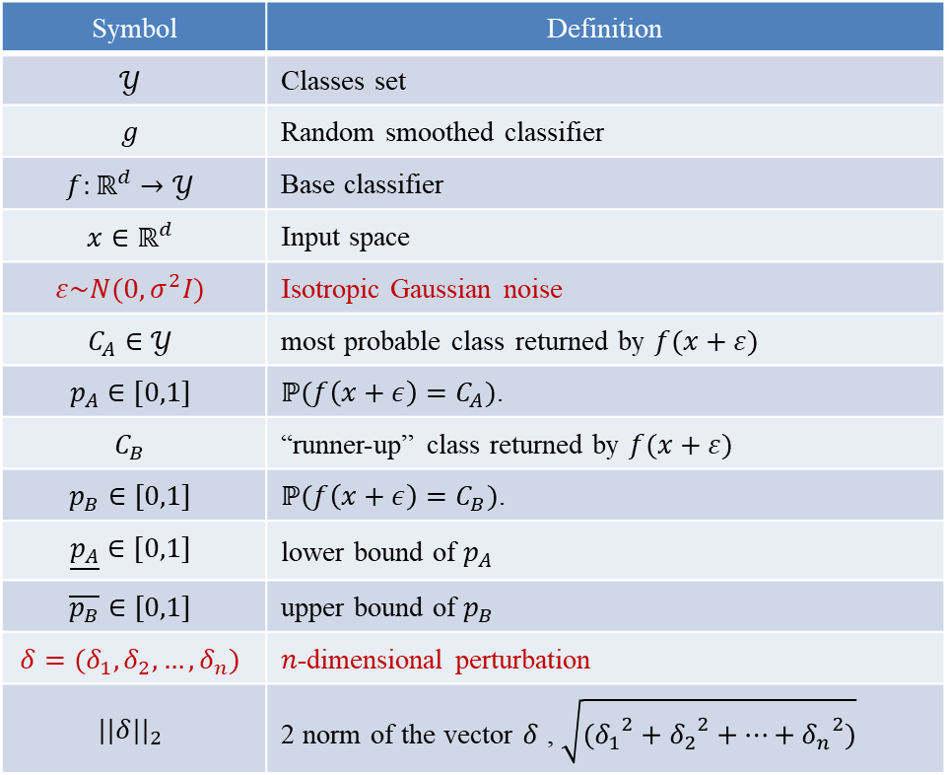
Randomized Smoothing
Notation
Symbol | Definition
$$𝒴$$ | Classes set
$$g$$ | Random smoothed classifier
$$f:ℝ^{d}→𝒴$$ | Base classifier
$$x∈ℝ^{d}$$ | Input space
$$ε\sim N(0,σ^{2}I)$$ | Isotropic Gaussian noise
$$C_{A}∈𝒴$$ | most probable class returned by $f(x+ε)$
$$p_{A}∈[0,1]$$ | $ℙ(f\left(x+ε\right)=C_{A})$.
$$C_{B}$$ | “runner-up” class returned by $f(x+ε)$
$$p_{B}∈[0,1]$$ | $ℙ(f\left(x+ε\right)=C_{B})$.
$$\underline{p_{A}}∈[0,1]$$ | lower bound of $p_{A}$
$$\overline{p_{B}}∈[0,1]$$ | upper bound of $p_{B}$
$$δ=(δ_{1},δ_{2},…,δ_{n})$$ | $n$-dimensional perturbation
$${||δ||}_{2}$$ | 2 norm of the vector $δ$ , $\sqrt{({δ_{1}}^{2}+{δ_{2}}^{2}+…+{δ_{n}}^{2})}$
Cohen, Jeremy, Elan Rosenfeld, and Zico Kolter. Certified adversarial robustness via randomized smoothing. ICML 2019.

Slide 10
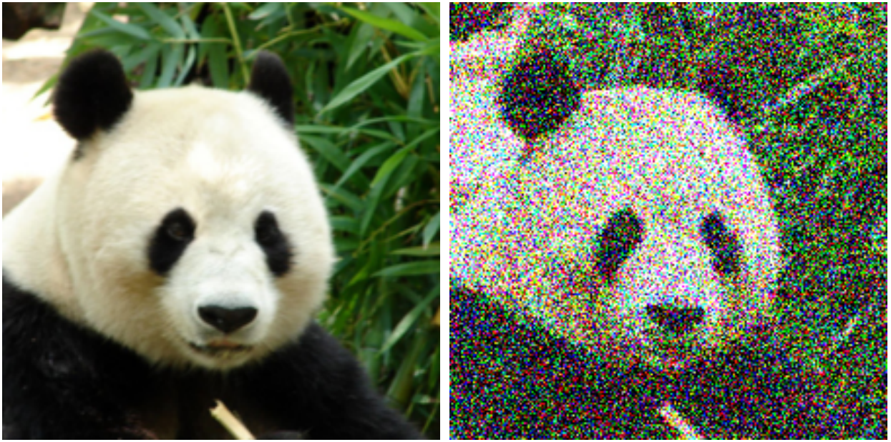
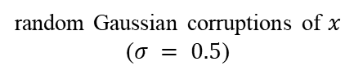
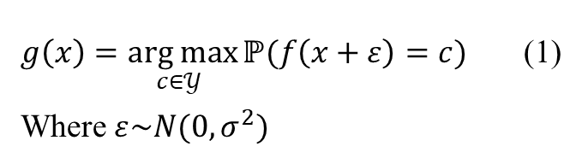
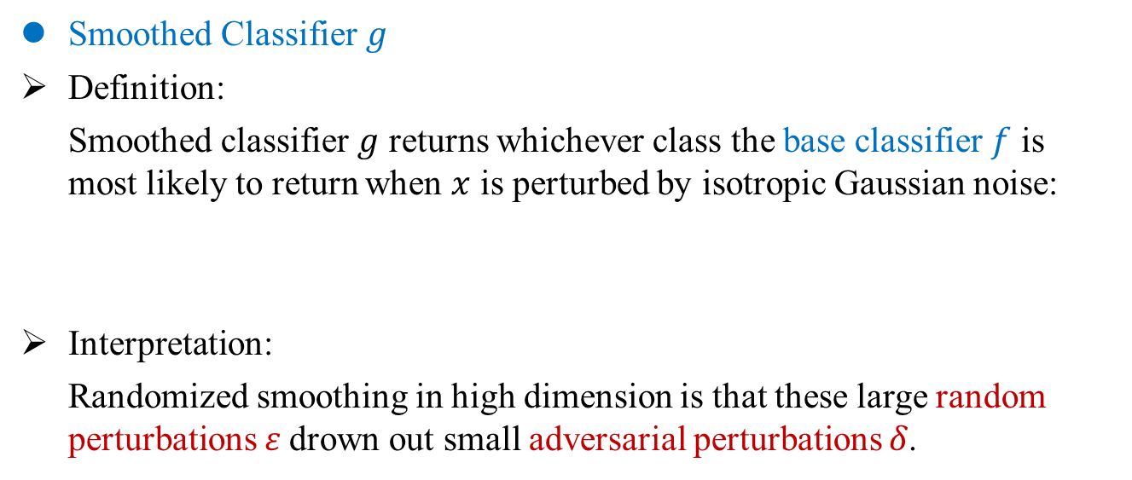
Randomized Smoothing
Algorithm
Smoothed Classifier $g$
Definition:
Smoothed classifier $g$ returns whichever class the base classifier $f$ is most likely to return when $x$ is perturbed by isotropic Gaussian noise:
Interpretation:
Randomized smoothing in high dimension is that these large random perturbations 𝜀 drown out small adversarial perturbations 𝛿.
$g\left(x\right)=\underset{c∈𝒴 }{arg max}{ℙ(f\left(x+ε\right)=c)}$ (1)
Where $ε\sim N(0,σ^{2})$
random Gaussian corruptions of $x$ ($σ = 0.5$)
Lecuyer Mathias. Certified robustness to adversarial examples with differential privacy. IEEE S&P 2019.
Notes:
数学期望是试验中每次可能结果的概率乘以其结果的总和，

Slide 11
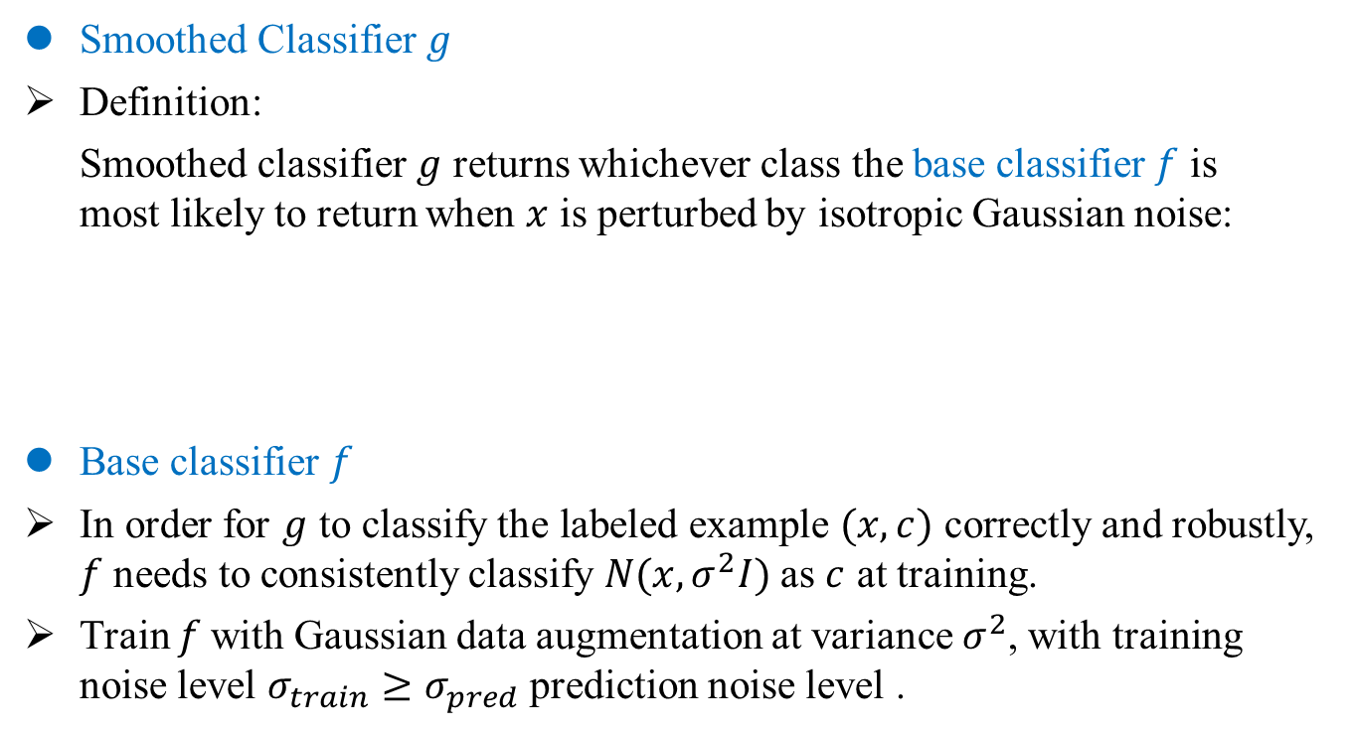
Randomized Smoothing
Algorithm
Smoothed Classifier $g$
Definition:
Smoothed classifier $g$ returns whichever class the base classifier $f$ is most likely to return when $x$ is perturbed by isotropic Gaussian noise:
Base classifier $f$
In order for $g$ to classify the labeled example $(x, c)$correctly and robustly, $f$ needs to consistently classify $N(x,σ^{2}I)$as $c$ at training.
Train $f$with Gaussian data augmentation at variance $σ^{2}$, with training noise level $σ_{train}≥σ_{pred}$ prediction noise level .
$g\left(x\right)=\underset{c∈𝒴 }{arg max}{ℙ(f\left(x+ε\right)=c)}$ (1)
Where $ε\sim N(0,σ^{2})$
Lecuyer Mathias. Certified robustness to adversarial examples with differential privacy. IEEE S&P 2019.
Notes:
数学期望是试验中每次可能结果的概率乘以其结果的总和，

Slide 12
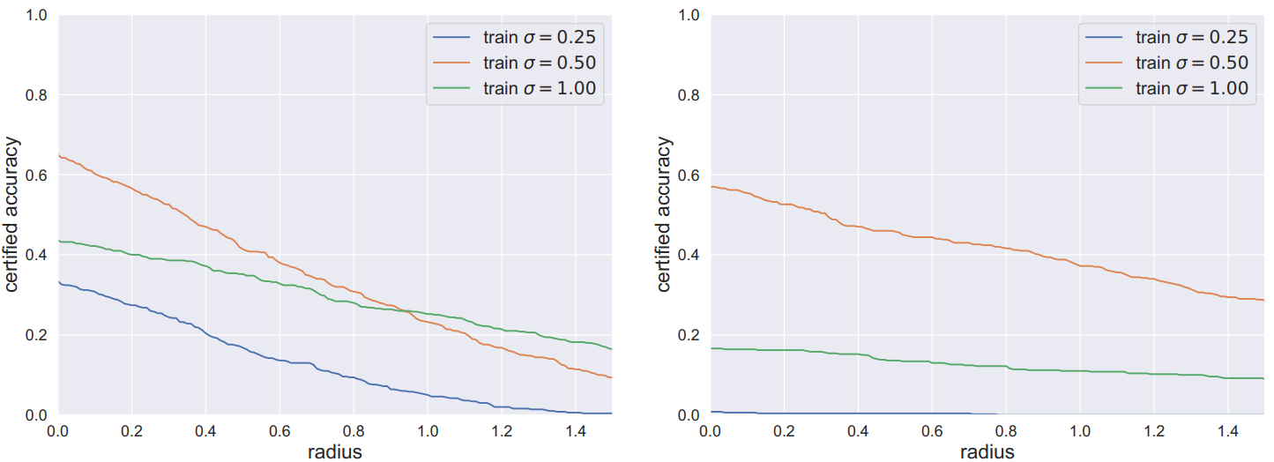
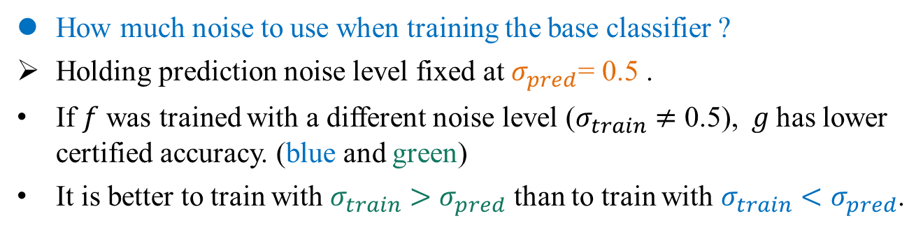
Randomized Smoothing
Algorithm
How much noise to use when training the base classifier ?
Holding prediction noise level fixed at $σ_{pred}$= 0.5 .
If $f$ was trained with a different noise level ($σ_{train}≠$ 0.5), $g$ has lower certified accuracy. (blue and green)
It is better to train with $σ_{train}$ $>σ_{pred}$ than to train with $σ_{train}$ $<σ_{pred}$.
(a) CIFAR-10
Figure 15
(b) ImageNet
Cohen, Jeremy, Elan Rosenfeld, and Zico Kolter. Certified adversarial robustness via randomized smoothing. ICML 2019.

Slide 13
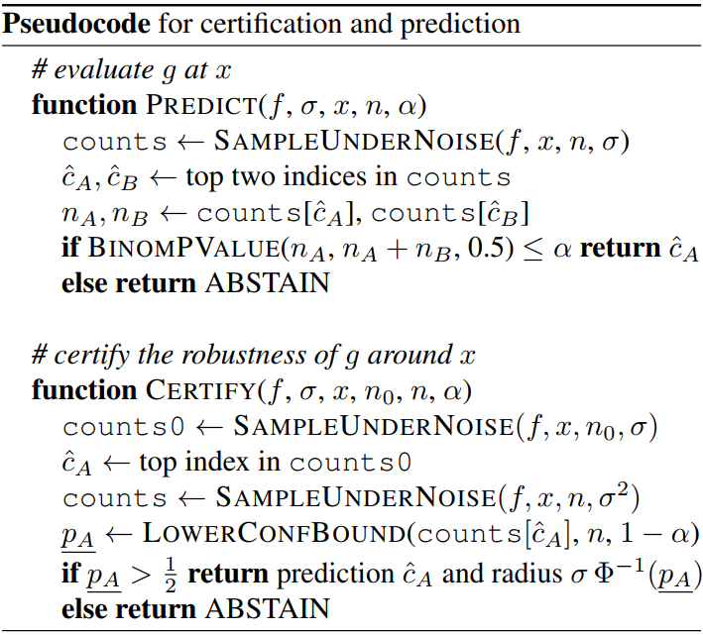
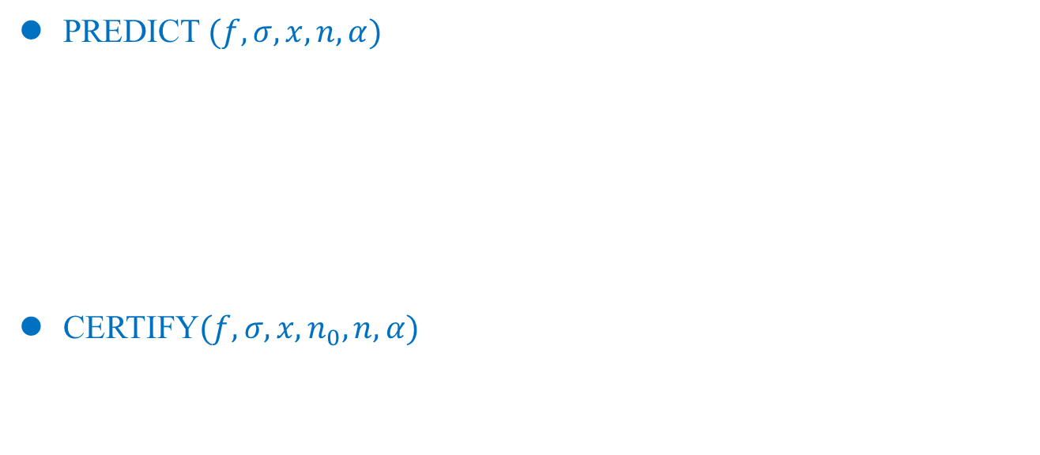
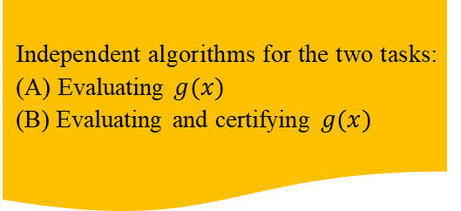
Randomized Smoothing
Algorithm
Independent algorithms for the two tasks:
(A) Evaluating $g(x)$
(B) Evaluating and certifying $g(x)$
PREDICT$(f, σ, x, n, α)$
CERTIFY$(f, σ, x, n_{0}, n, α)$
1
2
3
Cohen, Jeremy, Elan Rosenfeld, and Zico Kolter. Certified adversarial robustness via randomized smoothing. ICML 2019.

Slide 14
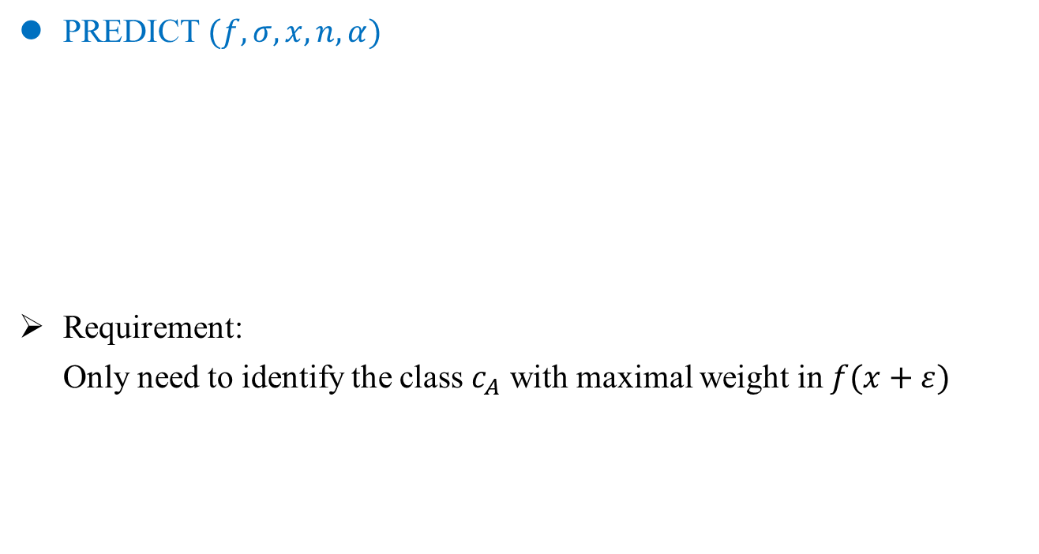
Randomized Smoothing
Algorithm
PREDICT$(f, σ, x, n, α)$
Requirement:
Only need to identify the class $c_{A}$ with maximal weight in $f(x+ε)$
1
2
Cohen, Jeremy, Elan Rosenfeld, and Zico Kolter. Certified adversarial robustness via randomized smoothing. ICML 2019.

Slide 15
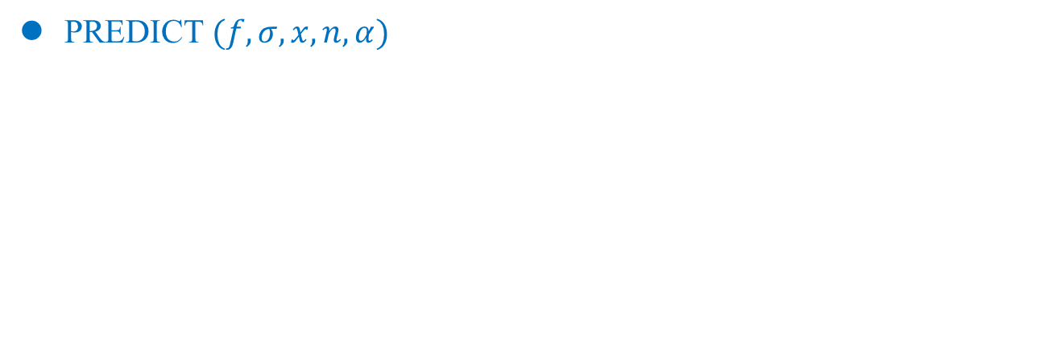
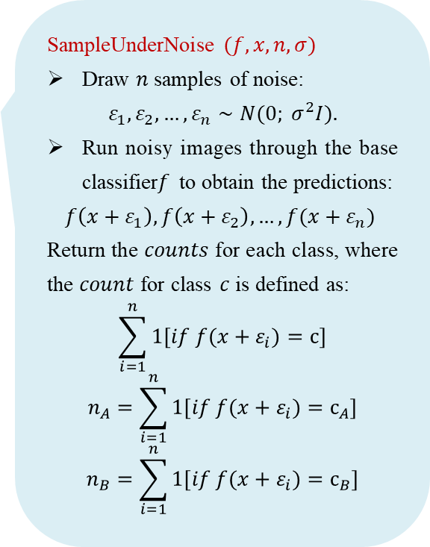
Randomized Smoothing
Algorithm
PREDICT$(f, σ, x, n, α)$
SampleUnderNoise $(f, x, n, σ)$
Draw $n$ samples of noise:
$$ε_{1}, ε_{2},…, ε_{n}∼N(0; σ^{2}I).$$
Run noisy images through the base classifier$f$ to obtain the predictions:
$$f\left(x+ε_{1}\right),f\left(x+ε_{2}\right),…,f(x+ε_{n})$$
Return the $counts$ for each class, where the $count$ for class $c$ is defined as:
$$\sum_{i=1}^{n}{1[if f(x+ε_{i})=c]}$$
$$n_{A}=\sum_{i=1}^{n}{1[if f(x+ε_{i})=c_{A}]}$$
$$n_{B}=\sum_{i=1}^{n}{1[if f(x+ε_{i})=c_{B}]}$$
1
2
Cohen, Jeremy, Elan Rosenfeld, and Zico Kolter. Certified adversarial robustness via randomized smoothing. ICML 2019.

Slide 16
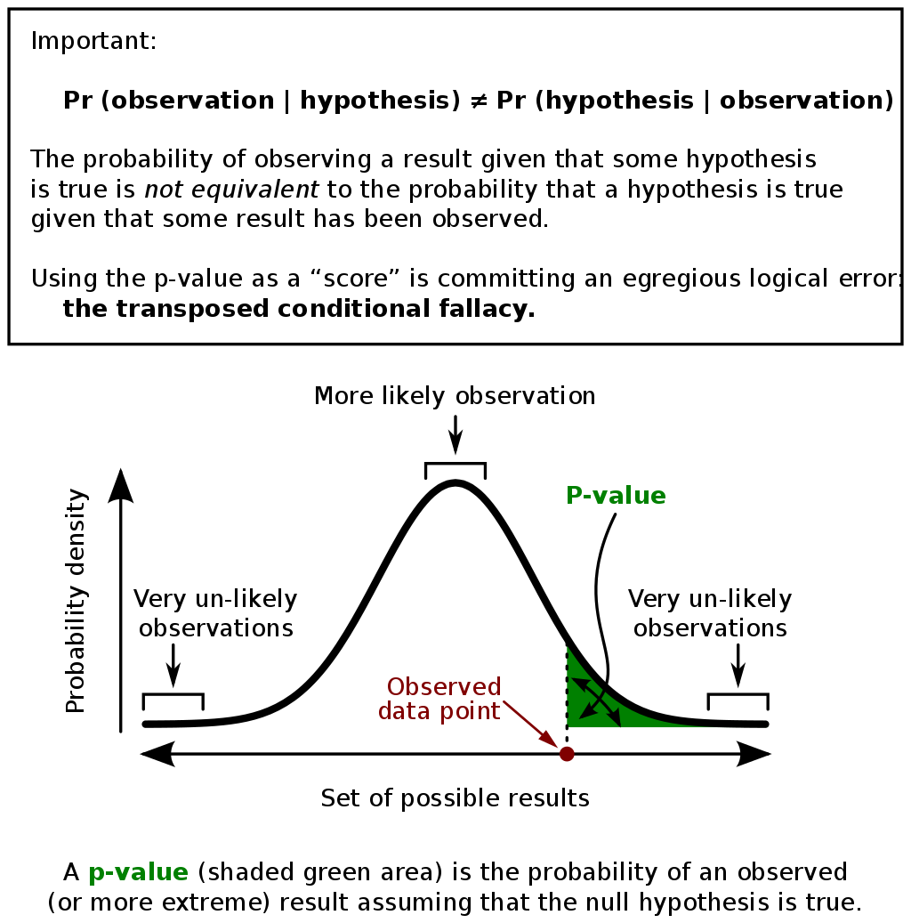
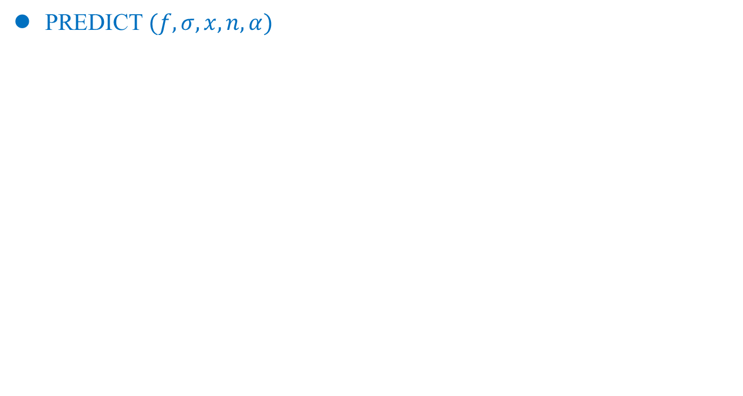
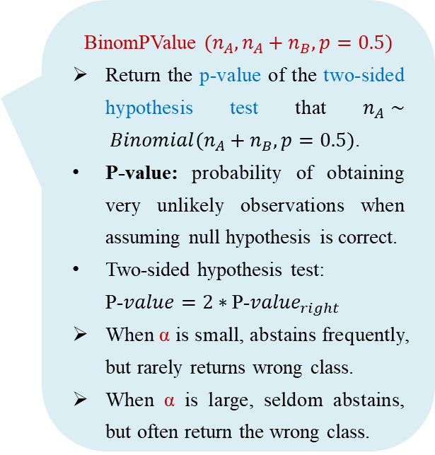
Randomized Smoothing
Algorithm
PREDICT$(f, σ, x, n, α)$
1
BinomPValue $(n_{A}, n_{A}+n_{B}, p=0.5)$
Return the p-value of the two-sided hypothesis test that $n_{A}∼ Binomial(n_{A}+n_{B},p=0.5)$.
P-value: probability of obtaining very unlikely observations when assuming null hypothesis is correct.
Two-sided hypothesis test:
P-$value=2∗$P-$value_{right}$
When α is small, abstains frequently, but rarely returns wrong class.
When α is large, seldom abstains, but often return the wrong class.
2
Hung, Kenneth, William Fithian. "Rank verification for exponential families." The Annals of Statistics 47.2 (2019): 758-782.
Notes:
$n_{A}$服从二项分布Binomial($n_{A}+n_{B};p$)，表示做（$n_{A}+n_{B}$）次独立重复的伯努利试验，每次事件A (被预测为$c_{A}$) 发生的概率为$p$. （$n_{A}+n_{B}$)次实验中，事件A (被预测为$c_{A}$) 发生的总次数计为随机变量$n_{A}$。那么，$n_{A}$服从参数为$n_{A}+n_{B}和p$的二项分布.
P值：原假设为真时取到极端情况的概率
双边假设检验P值：如果是双侧检验,其p值通常是在单侧的基础上乘以2。
scipy.stats 模块包含大量概率分布、频率统计、统计检验、核密度估计、准蒙特卡洛等函数接口。scipy.stats.binom_test 是python的数学工具库 scipy 下的统计模块 scipy.stats 中的一项函数。是对伯努利实验中成功概率为$p$的原假设的精确双边检验。

Slide 17
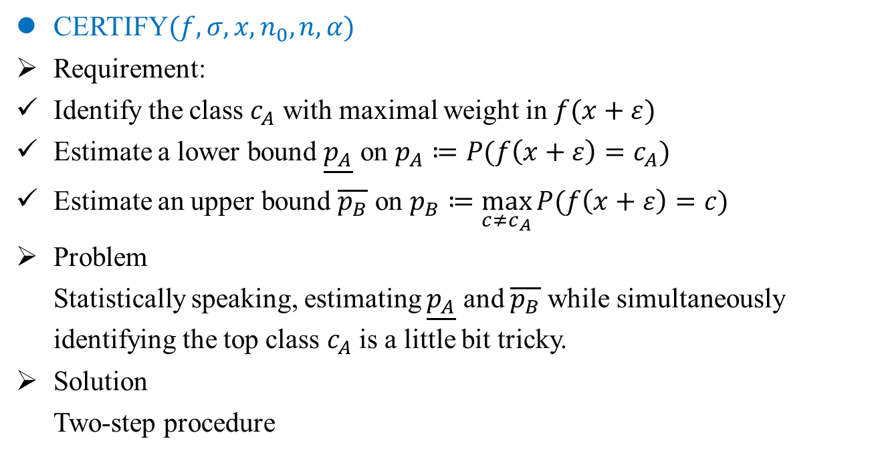
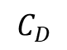
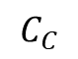
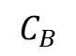
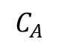
Randomized Smoothing
Algorithm
CERTIFY$(f, σ, x, n_{0}, n, α)$
Requirement:
Identify the class $c_{A}$ with maximal weight in $f(x+ε)$
Estimate a lower bound $\underline{p_{A}}$ on $p_{A}≔P(f\left(x+ε\right)=c_{A})$
Estimate an upper bound $\overline{p_{B}}$ on $p_{B}≔\max_{c≠c_{A}}{P(f\left(x+ε\right)=c)}$
Problem
Statistically speaking, estimating $\underline{p_{A}}$ and $\overline{p_{B}}$ while simultaneously identifying the top class $c_{A}$ is a little bit tricky.
Solution
Two-step procedure
$$C_{A}$$
$$C_{B}$$
$$C_{C}$$
$$C_{D}$$
Cohen, Jeremy, Elan Rosenfeld, and Zico Kolter. Certified adversarial robustness via randomized smoothing. ICML 2019.

Slide 18
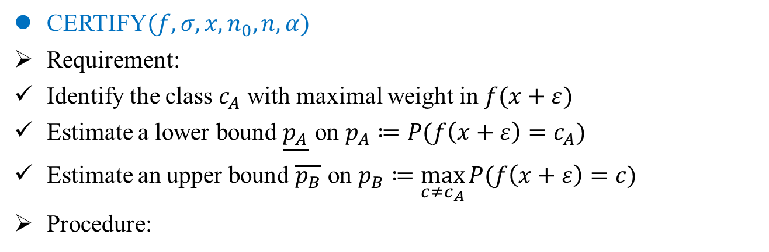
Randomized Smoothing
Algorithm
CERTIFY$(f, σ, x, n_{0}, n, α)$
Requirement:
Identify the class $c_{A}$ with maximal weight in $f(x+ε)$
Estimate a lower bound $\underline{p_{A}}$ on $p_{A}≔P(f\left(x+ε\right)=c_{A})$
Estimate an upper bound $\overline{p_{B}}$ on $p_{B}≔\max_{c≠c_{A}}{P(f\left(x+ε\right)=c)}$
Procedure:
3
Cohen, Jeremy, Elan Rosenfeld, and Zico Kolter. Certified adversarial robustness via randomized smoothing. ICML 2019.

Slide 19
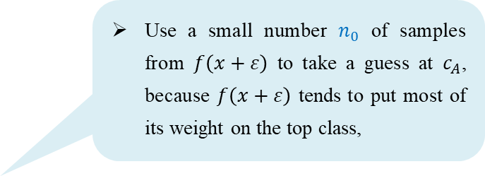
Randomized Smoothing
Algorithm
CERTIFY$(f, σ, x, n_{0}, n, α)$
Requirement:
Identify the class $c_{A}$ with maximal weight in $f(x+ε)$
Estimate a lower bound $\underline{p_{A}}$ on $p_{A}≔P(f\left(x+ε\right)=c_{A})$
Estimate an upper bound $\overline{p_{B}}$ on $p_{B}≔\max_{c≠c_{A}}{P(f\left(x+ε\right)=c)}$
Procedure:
Use a small number $n_{0}$ of samples from $f\left(x+ε\right)$ to take a guess at $c_{A}$, because $f\left(x+ε\right)$ tends to put most of its weight on the top class,
3
Cohen, Jeremy, Elan Rosenfeld, and Zico Kolter. Certified adversarial robustness via randomized smoothing. ICML 2019.

Slide 20
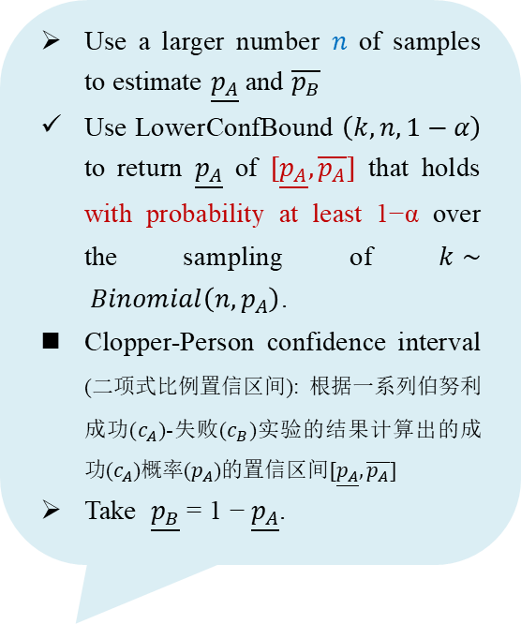
Randomized Smoothing
Algorithm
CERTIFY$(f, σ, x, n_{0}, n, α)$
Requirement:
Identify the class $c_{A}$ with maximal weight in $f(x+ε)$
Estimate a lower bound $\underline{p_{A}}$ on $p_{A}≔P(f\left(x+ε\right)=c_{A})$
Estimate an upper bound $\overline{p_{B}}$ on $p_{B}≔\max_{c≠c_{A}}{P(f\left(x+ε\right)=c)}$
Procedure:
Use a larger number $n$ of samples to estimate $\underline{p_{A}}$ and $\overline{p_{B}}$
Use LowerConfBound $\left(k, n, 1−α\right)$ to return $\underline{p_{A}}$ of $[\underline{p_{A}},\overline{p_{A}}]$ that holds with probability at least 1−α over the sampling of $k∼ Binomial\left(n,p_{A}\right)\text{.}$
Clopper-Person confidence interval (二项式比例置信区间): 根据一系列伯努利成功($c_{A}$)-失败($c_{B}$)实验的结果计算出的成功($c_{A}$)概率($p_{A}$)的置信区间$[\underline{p_{A}},\overline{p_{A}}]$
Take $\underline{p_{B}}$ = 1 − $\underline{p_{A}}$.
3
Cohen, Jeremy, Elan Rosenfeld, and Zico Kolter. Certified adversarial robustness via randomized smoothing. ICML 2019.
Notes:
$k∼Binomial\left(n;p\right)$分布表明：执行n次预测，其中k次分类为cA, 每次实验预测为cA的概率是p.
未被分配给CA的概率更有可能完全被分给CB，而不是平均的分给所有其它类别

Slide 21
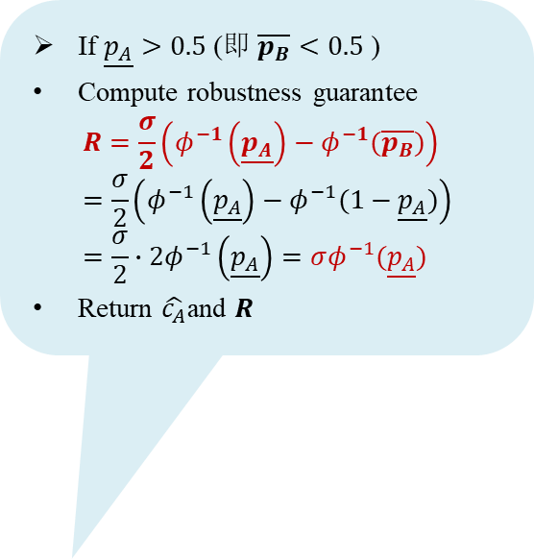
Randomized Smoothing
Algorithm
CERTIFY$(f, σ, x, n_{0}, n, α)$
Requirement:
Identify the class $c_{A}$ with maximal weight in $f(x+ε)$
Estimate a lower bound $\underline{p_{A}}$ on $p_{A}≔P(f\left(x+ε\right)=c_{A})$
Estimate an upper bound $\overline{p_{B}}$ on $p_{B}≔\max_{c≠c_{A}}{P(f\left(x+ε\right)=c)}$
Procedure:
If $\underline{p_{A}}>0.5$ (即 $\overline{p_{B}}<0.5$ )
Compute robustness guarantee
$$R=\frac{σ}{2}\left(φ^{−1}\left(\underline{p_{A}}\right)−φ^{−1}(\overline{p_{B}})\right)=\frac{σ}{2}\left(φ^{−1}\left(\underline{p_{A}}\right)−φ^{−1}(1−\underline{p_{A}})\right)=\frac{σ}{2}∙2φ^{−1}\left(\underline{p_{A}}\right)=σφ^{−1}(\underline{p_{A}})$$
Return $\hat{c_{A}}$and $R$
3
Cohen, Jeremy, Elan Rosenfeld, and Zico Kolter. Certified adversarial robustness via randomized smoothing. ICML 2019.

Slide 22
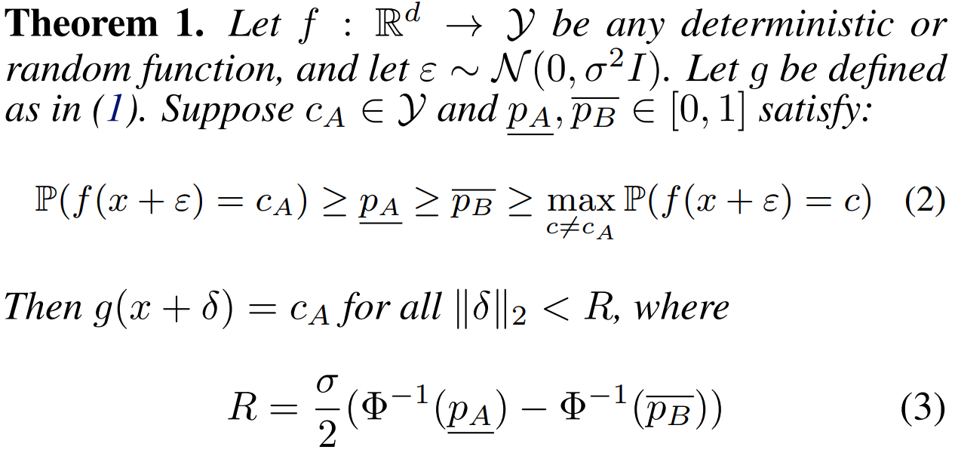
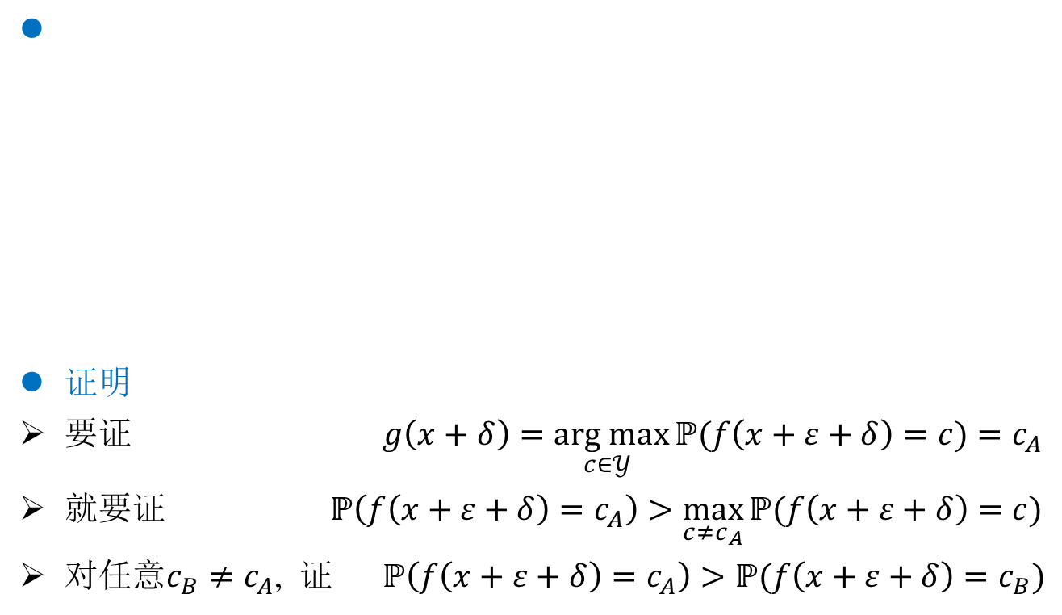
Randomized Smoothing
Radius
证明
要证 $g\left(x+δ\right)=\underset{c∈𝒴 }{arg max}{ℙ(f\left(x+ε+δ\right)=c)}=c_{A}$
就要证 $ℙ\left(f\left(x+ε+δ\right)=c_{A}\right)>\max_{c≠c_{A}}{ℙ(f\left(x+ε+δ\right)=c)}$
对任意$c_{B}≠c_{A}$, 证 $ℙ\left(f\left(x+ε+δ\right)=c_{A}\right)>ℙ(f\left(x+ε+δ\right)=c_{B})$
Cohen, Jeremy, Elan Rosenfeld, and Zico Kolter. Certified adversarial robustness via randomized smoothing. ICML 2019.

Slide 23
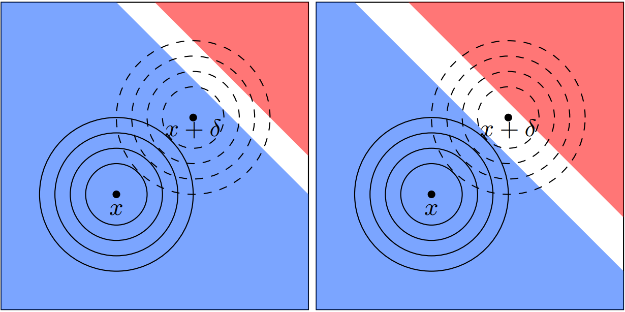
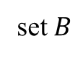

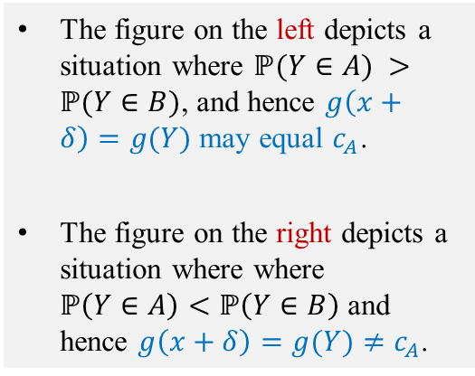
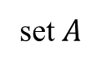

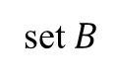






Randomized Smoothing
Radius
Illustration of the proof of Theorem 1.
当且仅当 $ℙ\left(f\left(Y∈A\right)\right)>ℙ\left(f\left(Y∈B\right)\right)$成立，有$ℙ\left(f\left(x+ε+δ\right)=c_{A}\right)>ℙ(f\left(x+ε+δ\right)=c_{B})$
定义：$A≔\{z:δ^{T}\left(z−x\right)≤σ\left|\left|δ\right|\right|φ^{−1}(\underline{p_{A}})\}$ $B≔\{z:δ^{T}\left(z−x\right)≤σ\left|\left|δ\right|\right|φ^{−1}(\overline{p_{B}})\}$
$ℙ\left(f\left(Y∈A\right)\right)=φ(φ^{−1}\left(\underline{p_{A}}\right)−\frac{\left|\left|δ\right|\right|}{σ})$ $ℙ\left(f\left(Y∈B\right)\right)=φ(φ^{−1}\left(\overline{p_{B}}\right)+\frac{\left|\left|δ\right|\right|}{σ})$
set $B$
set $B$
The figure on the left depicts a situation where $ℙ(Y∈A) >ℙ(Y∈B)$, and hence $g\left(x+δ\right)=g(Y)$ may equal $c_{A}$.
The figure on the right depicts a situation where where $ℙ\left(Y∈A\right)<ℙ\left(Y∈B\right)$ and hence $g\left(x+δ\right)=g(Y)≠c_{A}$.
$$Y:=x+δ+ε$$
$$Y$$
level sets of $Y$
$$X$$
$$X:=x+ε$$
level sets of $X$
set $A$
set $A$
Figure 9
Cohen, Jeremy, Elan Rosenfeld, and Zico Kolter. Certified adversarial robustness via randomized smoothing. ICML 2019.

Slide 24

Randomized Smoothing
Evaluation
Metric of normal classification
Standard test set accuracy: $STD.ACC=\frac{N_{g−Correctly}}{N_{g−Total}}$
Metric of certified classification
Certified test set accuracy at radius $r$:
$CERT.ACC=\frac{N_{g−Correctly−Robust}}{N_{g−Total}}$
$g$ classifies correctly (without abstaining) and certifies robust with a radius $R≥r$.
$r$ is similar toThreshold size $T$ defined in Lecuyer. IEEE S&P 2019.
Cohen, Jeremy, Elan Rosenfeld, and Zico Kolter. Certified adversarial robustness via randomized smoothing. ICML 2019.

Slide 25






Randomized Smoothing
Evaluation
Experiments with randomized smoothing on ImageNet with σ = 0.25.
Left: certified accuracies obtained using CERTIFY VS. those obtained using the guarantees derived in prior works (SP2019).
Middle: certified accuracy if the number of samples $n$ used by CERTIFY had been larger or smaller.
Right: certified accuracy as the failure probability $α$ of CERTIFY is varied.
$$α=0.000001$$
$$α=0.0001$$
higher certified accuracies
$$α=0.01$$
larger $n$, larger $R$
certified accuracy is not sensitive to α
Figure 8
Lecuyer, M. Certified robustness to adversarial examples with differential privacy. SP, 2019
Notes:
图 8（左）绘制了使用我们的定理 1 保证获得的认证准确度以及使用 Lecuyer 等人的类似界限获得的认证准确度。 （2019）和李等人。 （2018 年）。由于我们对认证半径 R 的表达式更大（实际上更紧密），我们的界限提供了更高的认证精度。 图 8（中）预测了如果 CERTIFY 使用更多或更少的样本 n（假设计数中的相对类别比例保持不变），认证准确度将如何变化。最后，图 8（右）绘制了随着置信度参数 α 变化的认证准确度。 请注意，经认证的精度对 α 不是很敏感。

Slide 26



Differential Privacy
Contribution
Prove the first tight robustness guarantee for randomized smoothing.
Analysis reveals that smoothing with Gaussian noise naturally induces certifiable robustness under the $l_{2}$ norm.
Suspect that other noise distributions might induce robustness to other perturbation sets such as general $l_{p}$ norm balls.
Enables the use of large networks on large scale datasets and does not constrain the architecture of the classifier.
Datasets:
ImageNet
CIFAR10
Networks:
ResNet
CIFAR10
ImageNet
Lecuyer, Mathias. Certified robustness to adversarial examples with differential privacy. IEEE S&P 2019.
Notes:
差分隐私，一种受密码学启发的隐私形式主义，为防御提供了严格、通用和灵活的基础。
数据中的微小变化会导致有界的输出变化。

Slide 27




Randomized Smoothing
Authors
Jeremy Cohen
PhD at CMU
Elan Rosenfeld
PhD at CMU
J. Zico Kolter
Associate Professor at CMU
Cohen, Jeremy, Elan Rosenfeld, and Zico Kolter. Certified adversarial robustness via randomized smoothing. ICML 2019.

Slide 28
Evaluation of Randomized Smoothing

Slide 29


Randomized Smoothing
Evaluation
The approximate certified accuracy VS. a high-probability lower bound on the certified accuracy.
Dataset: ImageNet
$f$: ResNet50
noise level: $σ=0.25$.
Testset: 500 examples
CERTIFY: $α= 0.001$.
Approximate certified accuracy can be converted into a lower bound on the true certified accuracy.
Figure 14
Cohen, Jeremy, Elan Rosenfeld, and Zico Kolter. Certified adversarial robustness via randomized smoothing. ICML 2019.

Slide 30








Randomized Smoothing
Evaluation
Randomized smoothing is effective for images of higher resolution.
Images in higher resolution can tolerate higher levels $σ$ of isotropic Gaussian noise before their class-distinguishing content gets destroyed.
In high resolution, smoothing can be performed with a larger $σ$, leading to larger $R=\frac{σ}{2}\left(φ^{−1}\left(\underline{p_{A}}\right)−φ^{−1}(\overline{p_{B}})\right)$.
$56×56$clean
$224×224$ clean
$56×56$noisy
$224×224$noisy
class “hummingbird”
Figure 4
$$σ=0.5$$
$$σ=0.5$$
Cohen, Jeremy, Elan Rosenfeld, and Zico Kolter. Certified adversarial robustness via randomized smoothing. ICML 2019.
Notes:
更高分辨率的图像可以在其类别区分内容被破坏之前容忍更高水平的各向同性高斯噪声。

Slide 31

Randomized Smoothing
Evaluation
Images additively corrupted by varying levels of Gaussian noise $N(0,σ^{2}I).$
Pixel values greater than $1.0 (=255)$or less than $0.0 (=0)$were clipped to $1.0$ or $0.0$.
Figure 17 CIFAR10
Figure 18 ImageNet
Cohen, Jeremy, Elan Rosenfeld, and Zico Kolter. Certified adversarial robustness via randomized smoothing. ICML 2019.

Slide 32


Randomized Smoothing
Evaluation
Certifying large radii requires many samples.
Left: Radius $R$ as a function of $\underline{p_{A}}$ , with $\overline{p_{B}}=1−\underline{p_{A}}$ and $σ=1$.
Right: $\underline{p_{A}}=α^{1/n}$, $α=0.001$, $σ=1$,$R=σΦ^{−1\left(\underline{p_{A}}\right)}=Φ^{−1}\left({1000}^{−\frac{1}{n}}\right)$.
The radius grows slowly with the number of samples.
Certifying a radius of $4σ(=4)$ with 99.9% ($α=0.001$) confidence would require $≈ {10}^{5}$samples.
Figure 5
Cohen, Jeremy, Elan Rosenfeld, and Zico Kolter. Certified adversarial robustness via randomized smoothing. ICML 2019.

Slide 33
Randomized Smoothing
Evaluation
Certifying large radii requires many samples.
Left: Radius $R$ as a function of $\underline{p_{A}}$ , with $\overline{p_{B}}=1−\underline{p_{A}}$ and $σ=1$.
Right: $\underline{p_{A}}=α^{1/n}$, $α=0.001$, $σ=1$,$R=σΦ^{−1\left(\underline{p_{A}}\right)}=Φ^{−1}\left({1000}^{−\frac{1}{n}}\right)$.
The radius grows slowly with the number of samples.
Certifying a radius of $4σ(=4)$ with 99.9% ($α=0.001$) confidence would require $≈ {10}^{5}$samples.
Figure 5
Cohen, Jeremy, Elan Rosenfeld, and Zico Kolter. Certified adversarial robustness via randomized smoothing. ICML 2019.

Slide 34


Randomized Smoothing
Evaluation
Approximate certified accuracy on ImageNet.
Radius $r$.
Best hyperparameter $σ$ for that $r$.
Approximate certified accuracy at $r$ of corresponding smoothed classifier.
Standard accuracy of the corresponding smoothed classifier.
A perturbation with $l_{2}$ radius $1.0$ could change one pixel by 255, ten pixels by 80100 pixels by 25, or 1000 pixels by 8.
Random guessing on ImageNet would attain $0.1\%$ accuracy.
Table 1
Cohen, Jeremy, Elan Rosenfeld, and Zico Kolter. Certified adversarial robustness via randomized smoothing. ICML 2019.
Notes:
每行显示一个半径 𝑟、该半径的最佳超参数 𝜎、相应平滑分类器在半径 𝑟 处的近似认证准确度，以及相应平滑分类器的标准准确度。
为了给出比例感，具有 𝑙_2 半径 1.0 的扰动可以改变一个像素 x 255、十像素 x 80100 像素 x 25 或 1000 像素 x 8。
ImageNet 上的随机猜测将达到 0.1% 的准确度。

Slide 35


Randomized Smoothing
Evaluation
Approximate certified accuracy attained by randomized smoothing.
The dashed black line is an upper bound on the empirical robust accuracy of an undefended base classifier against $l_{2}$ attack (DeepFool).
There is a hard upper limit to the radius we can certify with high probability.
The hyperparameter $σ$ controls a robustness/accuracy tradeoff.
ImageNet
CIFAR10
ResNet50
Figure 6
110-layer residual network
Cohen, Jeremy, Elan Rosenfeld, and Zico Kolter. Certified adversarial robustness via randomized smoothing. ICML 2019.

Slide 36
Randomized Smoothing
Evaluation
Approximate certified accuracy attained by randomized smoothing.
The dashed black line is an upper bound on the empirical robust accuracy of an undefended base classifier against $l_{2}$ attack (DeepFool).
There is a hard upper limit to the radius we can certify with high probability.
The hyperparameter $σ$ controls a robustness/accuracy tradeoff.
ImageNet
CIFAR10
49%
37%
ResNet50
Figure 6
110-layer residual network
Cohen, Jeremy, Elan Rosenfeld, and Zico Kolter. Certified adversarial robustness via randomized smoothing. ICML 2019.

Slide 37
Randomized Smoothing
Evaluation
Approximate certified accuracy attained by randomized smoothing.
The dashed black line is an upper bound on the empirical robust accuracy of an undefended base classifier against $l_{2}$ attack (DeepFool).
There is a hard upper limit to the radius we can certify with high probability.
The hyperparameter $σ$ controls a robustness/accuracy tradeoff.
ImageNet
CIFAR10
49%
37%
ResNet50
Figure 6
110-layer residual network
Cohen, Jeremy, Elan Rosenfeld, and Zico Kolter. Certified adversarial robustness via randomized smoothing. ICML 2019.

Slide 38

Randomized Smoothing
Evaluation
Comparison to baseline approaches for certified $l_{2}$ robustness
The duality approach from Wong et al. (NIPS2018) [strongest]
The Lipschitz approach from Tsuzuku et al. (NIPS2018)
The approach from Weng et al. (ICLR2019);
The approach from Zhang et al. (NIPS2018)
Wong, E, Kolter, J. Z. Scaling provable adversarial defenses. NIPS, 2018.
Tsuzuku, Lipschitz-margin training: Scalable certification of perturbation invariance for deep neural networks. NIPS2018.
Webb, S., Kumar, M. P. Statistical verification of neural networks. ICLR2019.
Zhang, H., Daniel, L. Efficient neural network robustness certification with general activation functions. NIPS2018

Slide 39



Randomized Smoothing
Evaluation
Comparison to Wong et al. (NIPS2018)
Wong gives deterministic robustness guarantees.
Smoothing gives high-probabaility guaranatees.
Plot here the certified accuracy of Wong against the approximate certified accuracy of smoothing.
110-L ResNet
$$Blue>puple>green$$
NN trained by Wong are typically overregularized to the point that many filters/weights become identically zero.
Small ResNet
Wong:
3 kinds of settings of hyperparameter $ε$.
Small ResNet
Figure 7
Cohen, Jeremy, Elan Rosenfeld, and Zico Kolter. Certified adversarial robustness via randomized smoothing. ICML 2019.
Notes:
黄等人。 (2018) 提供确定性稳健性保证，而平滑提供高概率保证。
因此，我们在这里绘制了 Wong 等人的认证准确性, 近似认证的平滑精度
使用 Wong 的方法训练的神经网络通常被过度正则化，以至于许多过滤器/权重都变为零

Slide 40


Randomized Smoothing
Evaluation
Comparison to Tsuzuku (NIPS2018) and Zhang(NIPS2018)
Randomized smoothing with a 20-layer resnet ($f$) attains higher certified accuracy than the released models from other works on certified $l_{2}$ robustness.
On CIFAR10
On SVHN
(a) Tsuzuku
Figure 13
(b) Zhang
Cohen, Jeremy, Elan Rosenfeld, and Zico Kolter. Certified adversarial robustness via randomized smoothing. ICML 2019.

Slide 41


Randomized Smoothing
Radius (binary case)
证明
要证 $g\left(x+δ\right)=\underset{c∈𝒴 }{arg max}{ℙ(f\left(x+ε+δ\right)=c)}=c_{A}$
就要证 $ℙ\left(f\left(x+ε+δ\right)=c_{A}\right)>\max_{c≠c_{A}}{ℙ(f\left(x+ε+δ\right)=c)}$
即 要证 $ℙ\left(f\left(x+ε+δ\right)=c_{A}\right)>1−ℙ\left(f\left(x+ε+δ\right)=c_{A}\right)$
即 要证 $ℙ\left(f\left(x+ε+δ\right)=c_{A}\right)>\frac{1}{2}$
已知 $ℙ\left(f\left(x+ε\right)=c_{A}\right)≥\underline{p_{A}}$
下面的证明思路是：
证明在所有分类器$f$结构中，具有最差决策边界的一款$f$结构也满足$ℙ\left(f\left(x+ε+δ\right)=c_{A}\right)>\frac{1}{2}$，从而证明定理适用任何$f$结构。
Cohen, Jeremy, Elan Rosenfeld, and Zico Kolter. Certified adversarial robustness via randomized smoothing. ICML 2019.

Slide 42









Randomized Smoothing
Radius (binary case)
Illustration of $f^{∗}$ in two dimensions.
The concentric circles are the density contours of $N (x, σ^{2}I)$and $N(x+ δ, σ^{2}I)$.
Out of all base classifiers $f$ which classify $N (x, σ^{2}I)$as $c_{A}$ (blue) with probability$≥\underline{p_{A}}$, the “worst-case” $f^{∗}$ is the classifier which classifies $N(x+δ，σ^{2}I)$as $c_{A}$ with minimal probability.
$c_{A}$
$c_{A}$
Right
a linear classifier with decision boundary normal to the perturbation $δ$
$$N(x+ δ, σ^{2}I)$$
$$N(x+ δ, σ^{2}I)$$
$$N (x, σ^{2}I)$$
$$N (x, σ^{2}I)$$
Figure 3
Cohen, Jeremy, Elan Rosenfeld, and Zico Kolter. Certified adversarial robustness via randomized smoothing. ICML 2019.

Slide 43
Preliminary in Randomized Smoothing

Slide 44



Randomized Smoothing
Preliminary
Monte Carlo method
A computational algorithm that rely on repeated random sampling to obtain numerical results.
Example 1
Use a Monte Carlo method to evaluate the value of π.
$S_{\frac{1}{4}circle}=\frac{1}{4}∙π∙1^{2}=\frac{N\left(red\right)}{N\left(red\right)+N\left(blue\right)}$
Example 2
Use a Monte Carlo method to evaluate $F=\int_{a}^{b}{f\left(x\right)dx}$.
$\int_{a}^{b}{f\left(x\right)dx}=\int_{−2}^{5}{−x^{3}+6x^{2}−x+17dx}$
$<F^{N}> =\frac{1}{b−a}\sum_{i=0}^{N−1}{f\left(x_{i}\right)}=\frac{1}{5−(−2)}\sum_{i=0}^{N−1}{f\left(x_{i}\right)}$
$\lim_{N→∞}<F^{N}> =F⁡$
Cohen, Jeremy, Elan Rosenfeld, and Zico Kolter. Certified adversarial robustness via randomized smoothing. ICML 2019.
Notes:
数学期望是试验中每次可能结果的概率乘以其结果的总和，

Slide 45

Randomized Smoothing
Algorithm
Monte Carlo method
Use Monte Carlo method to evaluate prediction of the classifier around $x$.
Step 1 Input domain: noise $ε\sim N(0,σ^{2})$
Step 2 Generate $n$ noise samples: $ε_{1}, ε_{2},…, ε_{n}$
Step 3 Deterministic computation
Generate $n$ noisy samples: $x+ε_{1},x+ε_{2},…,x+ε_{n}$
Input them to the classifier $f$ to obtain the predictions:
$f\left(x+ε_{1}\right),f\left(x+ε_{2}\right),…,f(x+ε_{n})$
Step 4 Aggregate the results
Compute the $counts$ for each class
Return the class which appeared much more often than any other class.
Cohen, Jeremy, Elan Rosenfeld, and Zico Kolter. Certified adversarial robustness via randomized smoothing. ICML 2019.
Notes:
数学期望是试验中每次可能结果的概率乘以其结果的总和，

Slide 46


Randomized Smoothing
Preliminary
Monte Carlo method
Procedure
Step 1 Define a domain of possible inputs
Step 2 Generate inputs randomly from a probability distribution over the input domain
Step 3 Perform a deterministic computation on the inputs
Step 4 Aggregate the results
Details of Step 2
For $N(μ,σ^{2})$ , CDF $φ_{μ,σ^{2}}(x)$with value range [0,1]
Inverse CDF ${φ^{−1}}_{μ,σ^{2}}(p)$with input range[0,1]
Randomly input p to ${φ^{−1}}_{μ,σ^{2}}(p)$
Output $x\sim N(μ,σ^{2})$
Cohen, Jeremy, Elan Rosenfeld, and Zico Kolter. Certified adversarial robustness via randomized smoothing. ICML 2019.

Slide 47
Proof in Randomized Smoothing

Slide 48
Randomized Smoothing
Radius
证明
要证 $g\left(x+δ\right)=\underset{c∈𝒴 }{arg max}{ℙ(f\left(x+ε+δ\right)=c)}=c_{A}$
就要证 $ℙ\left(f\left(x+ε+δ\right)=c_{A}\right)>\max_{c≠c_{A}}{ℙ(f\left(x+ε+δ\right)=c)}$
对任意$c_{B}≠c_{A}$, 证 $ℙ\left(f\left(x+ε+δ\right)=c_{A}\right)>ℙ(f\left(x+ε+δ\right)=c_{B})$
Cohen, Jeremy, Elan Rosenfeld, and Zico Kolter. Certified adversarial robustness via randomized smoothing. ICML 2019.

Slide 49

Randomized Smoothing
Radius
证明
固定类别$c_{B}$，要证 $ℙ\left(f\left(x+ε+δ\right)=c_{A}\right)>ℙ(f\left(x+ε+δ\right)=c_{B})$
简写 $X≔\left(x+ε\right)\sim N\left(x,σ^{2}I\right)$
$Y≔\left(x+ε+δ\right)\sim N(x+δ,σ^{2}I)$
即 要证 $ℙ\left(f\left(Y\right)=c_{A}\right)>ℙ(f\left(Y\right)=c_{B})$ (9)
已知 $ℙ\left(f\left(x+ε\right)=c_{A}\right)≥\underline{p_{A}}≥\overline{p_{B}}≥\max_{c≠c_{A}}{ℙ(f\left(x+ε\right)=c)}$
因此 $ℙ\left(f\left(x+ε\right)=c_{A}\right)≥\underline{p_{A}}≥\overline{p_{B}}≥ℙ(f\left(x+ε\right)=c_{B})$
即 已知 $ℙ\left(f\left(X\right)=c_{A}\right)≥\underline{p_{A}}$, $ℙ\left(f\left(X\right)=c_{B}\right)≤\overline{p_{B}}$ (8)
下面的证明思路是：
先证明 $ℙ\left(f\left(Y\right)=c_{A}\right)≥value_{A}$， $ℙ\left(f\left(Y\right)=c_{B}\right)≤value_{B}$
再证明 $value_{A}>value_{B}$
联立得 $ℙ\left(f\left(Y\right)=c_{A}\right)$ $≥value_{A}>value_{B}≥ℙ\left(f\left(Y\right)=c_{B}\right)$
Cohen, Jeremy, Elan Rosenfeld, and Zico Kolter. Certified adversarial robustness via randomized smoothing. ICML 2019.

Slide 50

Randomized Smoothing
Radius
证明
要证 $ℙ\left(f\left(Y\right)=c_{A}\right)>ℙ(f\left(Y\right)=c_{B})$ (9)
已知 $ℙ\left(f\left(X\right)=c_{A}\right)≥\underline{p_{A}}$, $ℙ\left(f\left(X\right)=c_{B}\right)≤\overline{p_{B}}$ (8)
先证明 $ℙ\left(f\left(Y\right)=c_{A}\right)≥value_{A}$， $ℙ\left(f\left(Y\right)=c_{B}\right)≤value_{B}$
取 $value_{A}=ℙ\left(Y∈A\right)$
$value_{B}=ℙ(Y∈B)$
定义 $A≔\{z:δ^{T}\left(z−x\right)≤σ\left|\left|δ\right|\right|φ^{−1}(\underline{p_{A}})\}$
$B≔\{z:δ^{T}\left(z−x\right)≤σ\left|\left|δ\right|\right|φ^{−1}(\overline{p_{B}})\}$
可证明 $ℙ\left(f\left(X∈A\right)\right)=φ\left(φ^{−1}(\underline{p_{A}})\right)=\underline{p_{A}}$,
$ℙ\left(f\left(X∈B\right)\right)=1−φ\left(φ^{−1}(1−\overline{p_{B}})\right)=\overline{p_{B}}$
代入已知得 $ℙ\left(f\left(X\right)=c_{A}\right)≥ℙ\left(f\left(X∈A\right)\right)$
$ℙ\left(f\left(X\right)=c_{B}\right)≤ℙ\left(f\left(X∈B\right)\right)$
Cohen, Jeremy, Elan Rosenfeld, and Zico Kolter. Certified adversarial robustness via randomized smoothing. ICML 2019.

Slide 51

Randomized Smoothing
Radius
证明
要证 $ℙ\left(f\left(Y\right)=c_{A}\right)>ℙ(f\left(Y\right)=c_{B})$ (9)
定义 $A≔\{z:δ^{T}\left(z−x\right)≤σ\left|\left|δ\right|\right|φ^{−1}(\underline{p_{A}})\}$
$B≔\{z:δ^{T}\left(z−x\right)≤σ\left|\left|δ\right|\right|φ^{−1}(\overline{p_{B}})\}$
已知 $ℙ\left(f\left(X\right)=c_{A}\right)≥ℙ\left(f\left(X∈A\right)\right)$
$ℙ\left(f\left(X\right)=c_{B}\right)≤ℙ\left(f\left(X∈B\right)\right)$
可证明 $ℙ\left(f\left(Y\right)=c_{A}\right)≥ℙ\left(f\left(Y∈A\right)\right)$ (10)
$ℙ\left(f\left(Y\right)=c_{B}\right)≤ℙ\left(f\left(Y∈B\right)\right)$ (11)
只还要证 $ℙ\left(f\left(Y∈A\right)\right)>ℙ\left(f\left(Y∈B\right)\right)$
可证明 $ℙ\left(f\left(Y∈A\right)\right)=φ(φ^{−1}\left(\underline{p_{A}}\right)−\frac{\left|\left|δ\right|\right|}{σ})$ (13)
$ℙ\left(f\left(Y∈B\right)\right)=φ(φ^{−1}\left(\overline{p_{B}}\right)+\frac{\left|\left|δ\right|\right|}{σ})$ (14)
Apply Neyman-Pearson lemma to prove
Cohen, Jeremy, Elan Rosenfeld, and Zico Kolter. Certified adversarial robustness via randomized smoothing. ICML 2019.

Slide 52

Randomized Smoothing
Radius
证明
要证 $ℙ\left(f\left(Y∈A\right)\right)>ℙ\left(f\left(Y∈B\right)\right)$
定义 $A≔\{z:δ^{T}\left(z−x\right)≤σ\left|\left|δ\right|\right|φ^{−1}(\underline{p_{A}})\}$
$B≔\{z:δ^{T}\left(z−x\right)≤σ\left|\left|δ\right|\right|φ^{−1}(\overline{p_{B}})\}$
已知 $ℙ\left(f\left(Y∈A\right)\right)=φ(φ^{−1}\left(\underline{p_{A}}\right)−\frac{\left|\left|δ\right|\right|}{σ})$ (13)
$ℙ\left(f\left(Y∈B\right)\right)=φ(φ^{−1}\left(\overline{p_{B}}\right)+\frac{\left|\left|δ\right|\right|}{σ})$ (14)当且仅当 $φ(φ^{−1}\left(\underline{p_{A}}\right)−\frac{\left|\left|δ\right|\right|}{σ})>φ(φ^{−1}\left(\overline{p_{B}}\right)+\frac{\left|\left|δ\right|\right|}{σ})$时，
$ℙ\left(f\left(Y∈A\right)\right)>ℙ\left(f\left(Y∈B\right)\right)$成立。
$变形$得， $φ^{−1}\left(\underline{p_{A}}\right)−\frac{\left|\left|δ\right|\right|}{σ}>φ^{−1}\left(\overline{p_{B}}\right)+\frac{\left|\left|δ\right|\right|}{σ}$
得证定理1 $\left|\left|δ\right|\right|<\frac{1}{2}σ[φ^{−1}\left(\underline{p_{A}}\right)−φ^{−1}\left(\overline{p_{B}}\right)]$
Cohen, Jeremy, Elan Rosenfeld, and Zico Kolter. Certified adversarial robustness via randomized smoothing. ICML 2019.

Slide 53
Randomized Smoothing
Radius (binary case)
证明
要证 $g\left(x+δ\right)=\underset{c∈𝒴 }{arg max}{ℙ(f\left(x+ε+δ\right)=c)}=c_{A}$
就要证 $ℙ\left(f\left(x+ε+δ\right)=c_{A}\right)>\max_{c≠c_{A}}{ℙ(f\left(x+ε+δ\right)=c)}$
即 要证 $ℙ\left(f\left(x+ε+δ\right)=c_{A}\right)>1−ℙ\left(f\left(x+ε+δ\right)=c_{A}\right)$
即 要证 $ℙ\left(f\left(x+ε+δ\right)=c_{A}\right)>\frac{1}{2}$
已知 $ℙ\left(f\left(x+ε\right)=c_{A}\right)≥\underline{p_{A}}$
下面的证明思路是：
证明在所有分类器$f$结构中，具有最差决策边界的一款$f$结构也满足$ℙ\left(f\left(x+ε+δ\right)=c_{A}\right)>\frac{1}{2}$，从而证明定理适用任何$f$结构。
Cohen, Jeremy, Elan Rosenfeld, and Zico Kolter. Certified adversarial robustness via randomized smoothing. ICML 2019.

Slide 54

Randomized Smoothing
Radius (binary case)
证明
要证 $ℙ\left(f\left(x+ε+δ\right)=c_{A}\right)>\frac{1}{2}$
已知 $ℙ\left(f\left(x+ε\right)=c_{A}\right)≥\underline{p_{A}}$
确定 最差情况下的$f$结构为线性分类器$f^{∗}$
就 要证 $ℙ\left(f^{∗}\left(x+ε+δ\right)=c_{A}\right)>\frac{1}{2}$
可证明 $ℙ\left(f^{∗}\left(x+ε+δ\right)=c_{A}\right)=Φ(Φ^{−1}\left(\underline{p_{A}}\right)−\frac{{\left|\left|δ\right|\right|}_{2}}{σ})$
即 要证 $Φ\left(Φ^{−1}\left(\underline{p_{A}}\right)−\frac{{\left|\left|δ\right|\right|}_{2}}{σ}\right)>\frac{1}{2}$
变形得 $Φ\left(Φ^{−1}\left(\underline{p_{A}}\right)−\frac{{\left|\left|δ\right|\right|}_{2}}{σ}\right)>Φ\left(0\right)$
$Φ^{−1}\left(\underline{p_{A}}\right)−\frac{{\left|\left|δ\right|\right|}_{2}}{σ}>0$
得证 ${\left|\left|δ\right|\right|}_{2}<σΦ^{−1}(\underline{p_{A}})$
Cohen, Jeremy, Elan Rosenfeld, and Zico Kolter. Certified adversarial robustness via randomized smoothing. ICML 2019.

Slide 55



Randomized Smoothing
$l_{2}$ball ($R$)
If we make no assumptions on the $f$beyond $ℙ\left(f\left(x+ε\right)=c_{A}\right)≥\underline{p_{A}}≥\overline{p_{B}}≥\max_{c≠c_{A}}{ℙ(f\left(x+ε\right)=c)}$, then the set of perturbations to which a Gaussian-smoothed classifier $g$ is provably robust is an $l_{2}$ ball.
证明
要满足 $\underline{p_{A}}+\overline{p_{B}}≤1$
定义 $A≔\{z:δ^{T}\left(z−x\right)≤σ\left|\left|δ\right|\right|φ^{−1}(\underline{p_{A}})\}$
$B≔\{z:δ^{T}\left(z−x\right)≤σ\left|\left|δ\right|\right|φ^{−1}(\overline{p_{B}})\}$
定义 $f\left(x\right)=\left\{\begin{aligned}c_{A}, if x∈A \\ c_{B}, if x∈B \\ c_{other}, otherwise\end{aligned}\right.$
Cohen, Jeremy, Elan Rosenfeld, and Zico Kolter. Certified adversarial robustness via randomized smoothing. ICML 2019.

Slide 56

Randomized Smoothing
$l_{2}$ball ($R$)
证明
要证 $g\left(x+δ\right)=\underset{c∈𝒴 }{arg max}{ℙ(f\left(x+ε+δ\right)=c)}≠c_{A}$
即 要证 $ℙ\left(f\left(x+ε+δ\right)=c_{A}\right)<ℙ(f\left(x+ε+δ\right)=c_{B})$
即 要证 $ℙ\left(Y∈A\right)<ℙ\left(Y∈B\right)$
已知 $ℙ\left(f\left(x+ε\right)=c_{A}\right)=ℙ\left(X∈A\right)=\underline{p_{A}}$
$ℙ\left(f\left(x+ε\right)=c_{B}\right)=ℙ\left(X∈B\right)=\overline{p_{B}}$
满足 $ℙ\left(f\left(x+ε\right)=c_{A}\right)≥\underline{p_{A}}≥\overline{p_{B}}≥\max_{c≠c_{A}}{ℙ\left(f\left(x+ε\right)=c\right)}$
可证明 $ℙ\left(f\left(Y∈A\right)\right)=φ(φ^{−1}\left(\underline{p_{A}}\right)−\frac{\left|\left|δ\right|\right|}{σ})$ (13)
$ℙ\left(f\left(Y∈B\right)\right)=φ(φ^{−1}\left(\overline{p_{B}}\right)+\frac{\left|\left|δ\right|\right|}{σ})$ (14)
Cohen, Jeremy, Elan Rosenfeld, and Zico Kolter. Certified adversarial robustness via randomized smoothing. ICML 2019.

Slide 57

Randomized Smoothing
$l_{2}$ball ($R$)
证明
要证 $ℙ\left(Y∈A\right)<ℙ\left(Y∈B\right)$
已知 $ℙ\left(f\left(Y∈A\right)\right)=φ(φ^{−1}\left(\underline{p_{A}}\right)−\frac{\left|\left|δ\right|\right|}{σ})$ (13)
$ℙ\left(f\left(Y∈B\right)\right)=φ(φ^{−1}\left(\overline{p_{B}}\right)+\frac{\left|\left|δ\right|\right|}{σ})$ (14)
当 $φ^{−1}\left(\underline{p_{A}}\right)−\frac{\left|\left|δ\right|\right|}{σ}<φ^{−1}\left(\overline{p_{B}}\right)+\frac{\left|\left|δ\right|\right|}{σ}$时，
有 $ℙ\left(Y∈A\right)<ℙ\left(Y∈B\right)$成立
变形得 $\left|\left|δ\right|\right|>\frac{1}{2}σ(φ^{−1}\left(\underline{p_{A}}\right)−φ^{−1}\left(\overline{p_{B}}\right))$
即 $\left|\left|δ\right|\right|>R$
得证 if $f$ is the base classifier for $g$, then $g(x+δ) ≠c_{A}$.
Cohen, Jeremy, Elan Rosenfeld, and Zico Kolter. Certified adversarial robustness via randomized smoothing. ICML 2019.

